Slide 1
Listening and Speaking Skills
Prepared by Vineetha Krishnan
Asst. Professor
Dept. of English
NSS College, Pandalam

Slide 2
Listening Skill
Introduction
Valuable skill in personal, academic and professional setting
Helps to get into a profession in communications
Very important in language learning
Students acquire vocabulary, grammar and better pronunciation
Listening occurs naturally in mothertongue

Slide 3
Definition
Listening as defined by international listening Association
“the active process of receiving, constructing meaning from, and responding to spoken and/or non-verbal messages. It involves the ability to retain information, as well as to react empathically or appreciatively to spoken and/or non-verbal messages”

Slide 4
Listening vs Hearing
Listening a deliberate and conscious act
Hearing is a passive act
Unlike hearing, listening improves through conscious effort and practice

Slide 5
Process of listening
Hearing
Understanding
Interpreting
Evaluating
Responding
Remembering

Slide 6
Problems in listening
Trouble catching the actual sounds of english
Inability to understand fast, natural native-sounding speech
Need to hear more than once
Limited vocabulary power
Problem in predicting what te speaker is going to say
Difficulty in interpreting the meaning of a long text

Slide 7
Barriers to listening
Emotional barriers
Psychological barriers
Linguistic/ semantic barriers
Socio-cultural barriers
Physiological barriers

Slide 8
How to overcome barriers
Avoid physical distractions
Empathise with the speaker
Try to understand the speaker's point of view
Try to understand cultural variations
Listen and read effectively
Practice good bod language tech

Slide 9
Conclusion
Listening creates acceptance and openness. It leads to learning and personal development. Good listening reduces stress and tension, minimises confusion and misunderstanding.

Slide 10
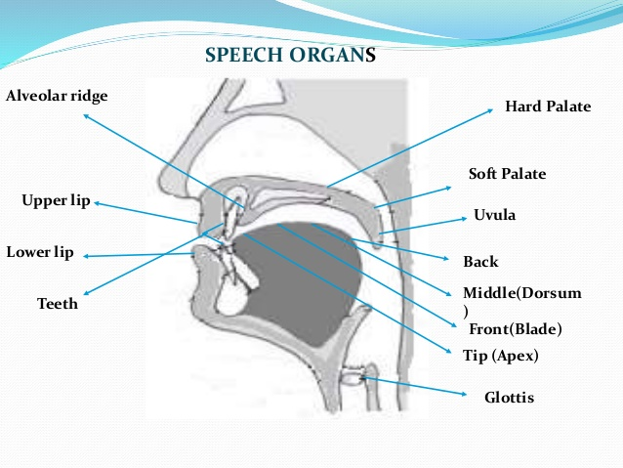
Organs of Speech

Slide 11
The organs of Speech
The lungs
The Larynx and the Vocal cords
The Pharynx
The Soft Palate
The mouth
The lips
The tongue

Slide 12
Phonetics
Why do we learn phonetics?
Phonetics familiarize ourselves with basic sounds of english language
Spoken english shows variations based on region, social class and levels of formality. So we need a standard in pronunciation

Slide 13
RP
It s the widely known and accepted pronunciation of English, Received Pronunciation
It is also known as BBC english or Queen's English
It is the pronunciation of the people of southern England

Slide 14
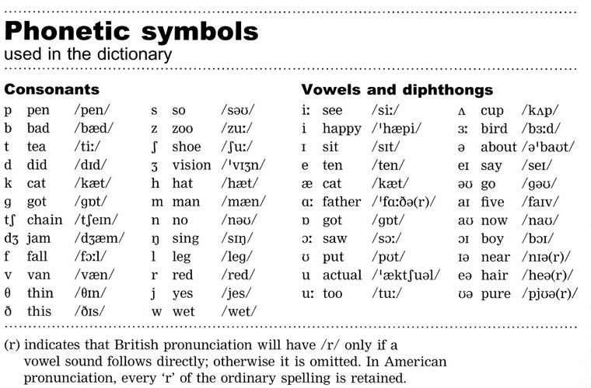
English Sounds

Slide 15
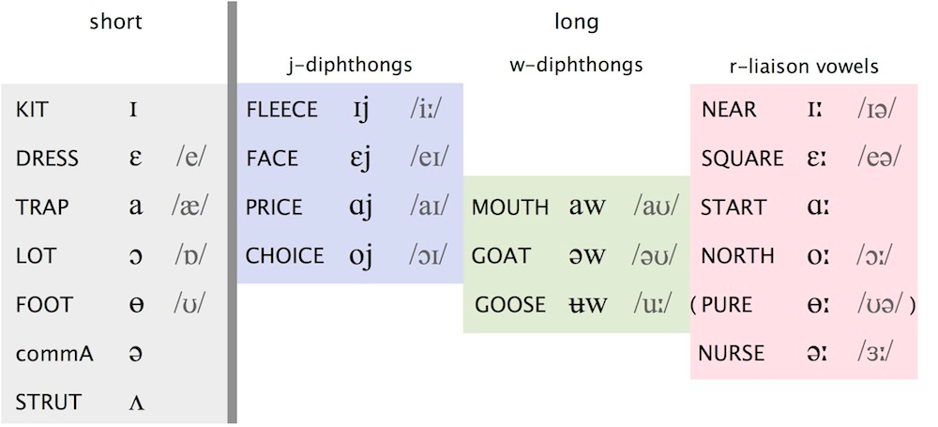
Vowels and Diphthongs

Slide 16
Consonants

Slide 17
The Syllable
A syllable is a unit of pronunciation which is uttered in one chest pulse. eg. The word begin is pronounced in two chest pulses.
Identify the syllables in the following words?
Table, teacher,mother, grammar, phonetics

Slide 18
Strong forms and weak forms
Form class words have only one pronunciation but function class words have many pronunciations

Slide 19
Intonation
Intonation refers to the falt l and rise of the voice while speaking.if the pitch of the voice moves from a high level to a low level it is calledfalling tone.if the pitch moves from a low levelto a high level it is called a rising intonation.

Slide 20
Conclusion
To Promote the intelligibility of indian English, indian speakers should be familiarised with the phonetic features of the english language-positions of the english phonemes, stress, rhythm and intonation in connected speech.

